Slide 1
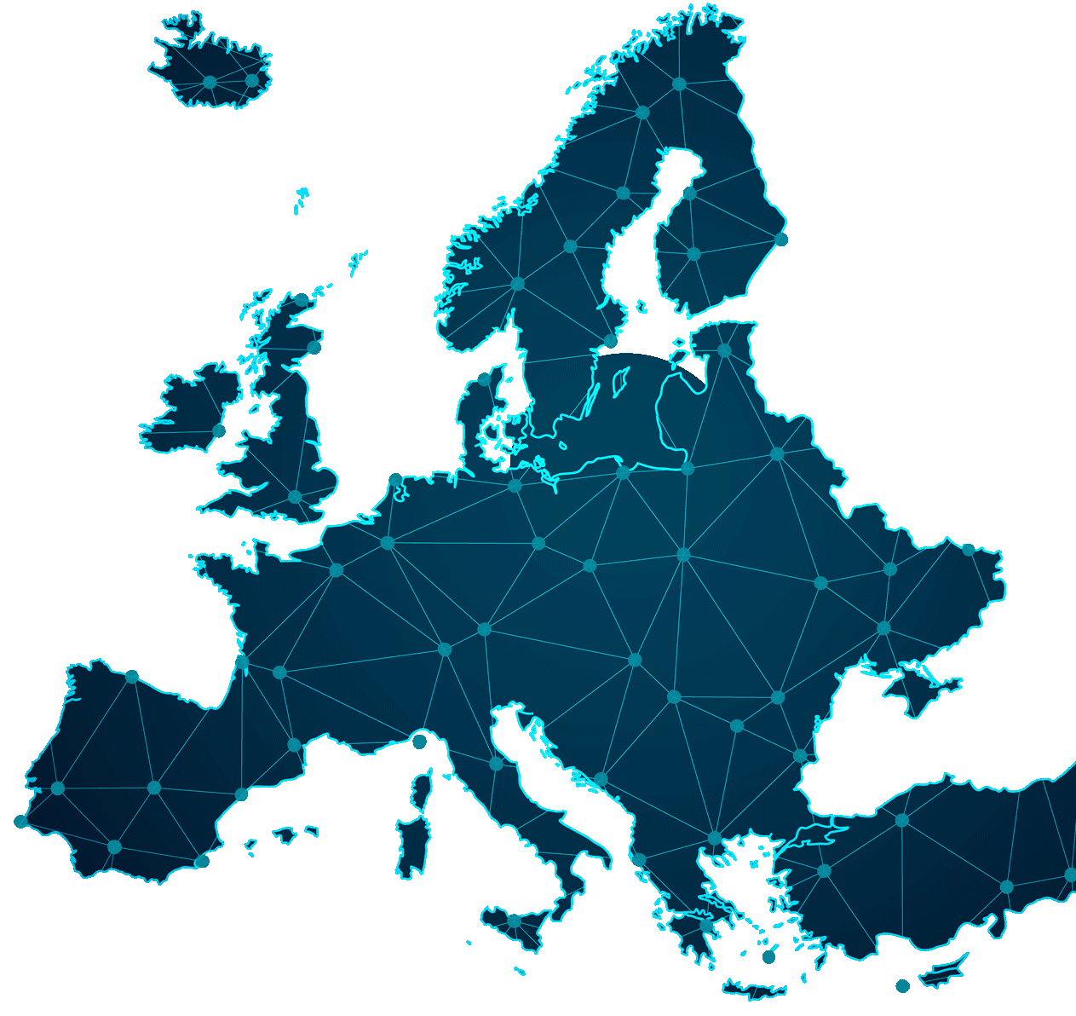
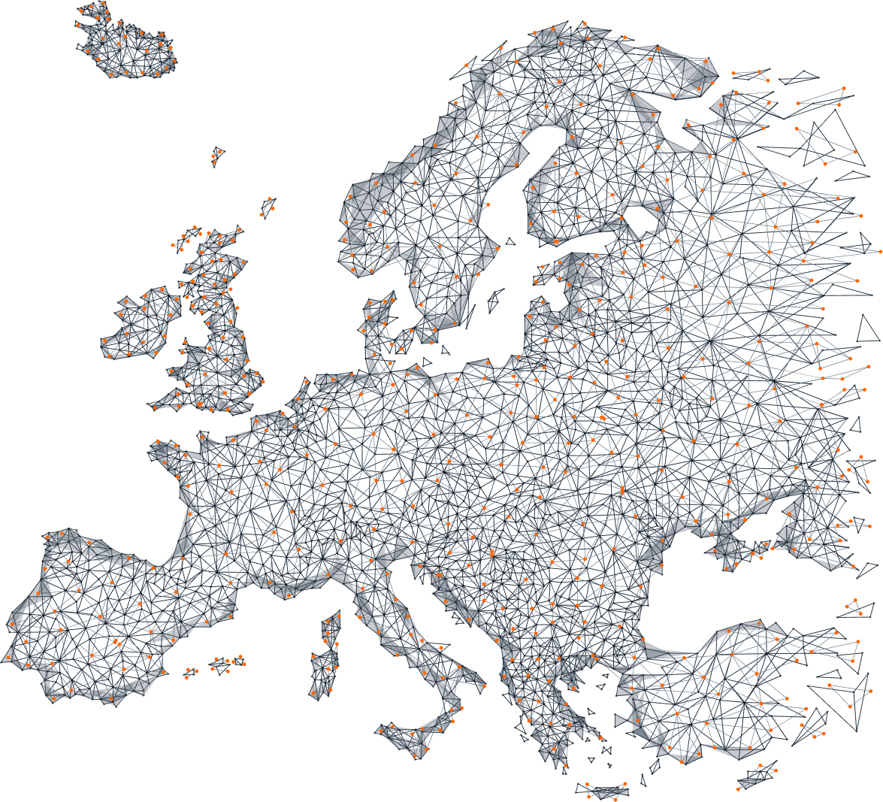




Alessandro Amato • Filippo Cipriani • Gabriele Corbo • Michelangelo Giuffrida • Riccardo Rosi • Paolo Timis • Aurelio Zizzo
Optimal Allocation and Sizing of
Electric Vehicle Charging Infrastructure
Multidisciplinary project OASIS
Academic Tutors: Michela Longo, Andrea Mazza
Company Tutors: Francesca Mapelli, Paolo Ciliento
Notes:
Key to go forward: “Although, in this context, one of the main constraints is precisely related to the charging network”
—-
Good afternoon everyone,
What we are going to present you today is our multidisciplinary project OASIS, which deals with the optimal allocation and sizing of electric vehicles charging infrastructure. Vehicle electrification is a key technology in tackling one of the most critical issues of today, which is climate change. For this reason, it is without a doubt a technical challenge of global importance!
In this context, one of the main constraints is precisely related to the charging network!
Vehicle electrification is a key technology in tackling climate change thus being a technical issue of global importance supported by governments and institutions; in this context, there is a particular aspect that constraints the spread of electric vehicles: the charging infrastructure.

Slide 2
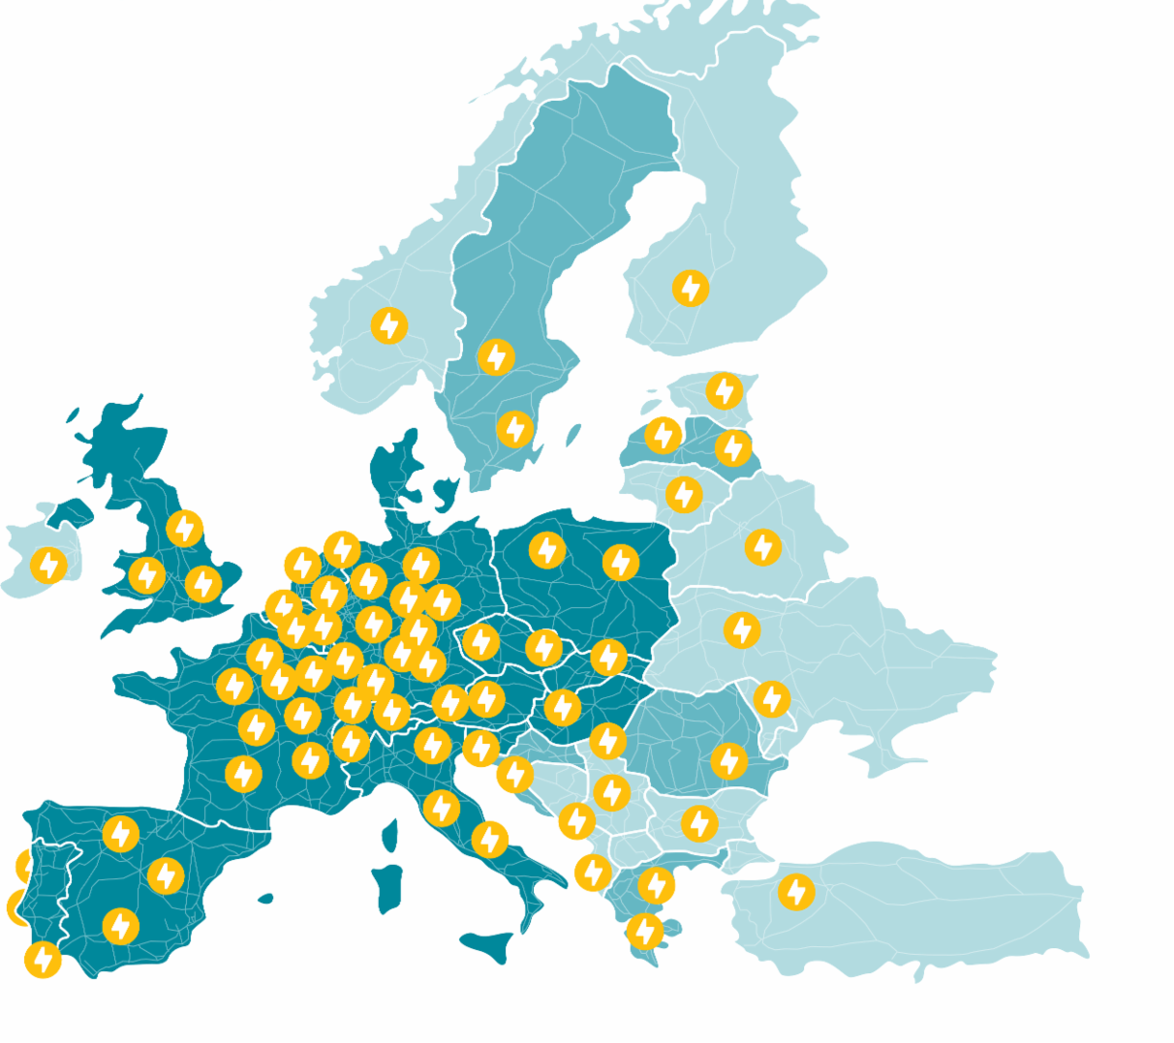
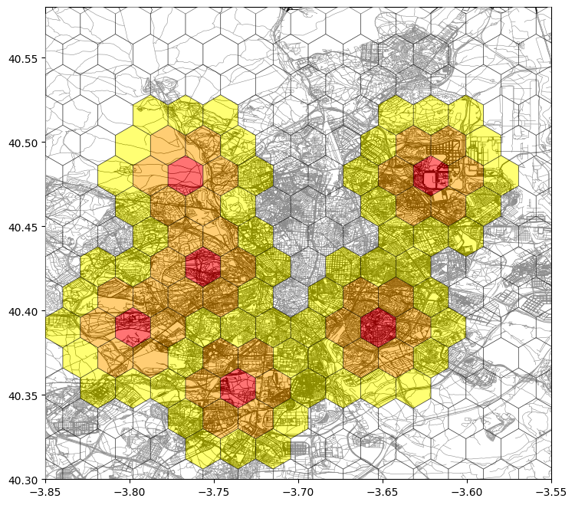
Introduction
OASIS mission: Optimal Allocation and Sizing of Electric Infrastructures basing on Predictive Simulations
?
Where to place the
next one?
Notes:
Key to go forward: “strategic positioning of superfast chargers, aiming to contribute to the mobility transition”
—----
As recent studies show, the main concern that prevents the Electric Vehicle adoption is IN FACT the lack of available charging infrastructure.
The mission of the OASIS team is exactly to solve this obstacle!
To do so we provide our company partners, ATLANTE, with an algorithm based on predictive simulations that supports the strategic positioning of superfast chargers, aiming to contribute to the mobility transition.
A study from Deloitte shows that the charging infrastructure is the top concern among customers in most countries; highlighting the relevance of this project
In this context the mission of the OASIS team is to provide Atlante (our company partners) with a tool that supports the strategic positioning of fast charging electric infrastructures; OASIS= Optimal Allocation and Sizing of Infrastructures basing on predictive simulations

Slide 3
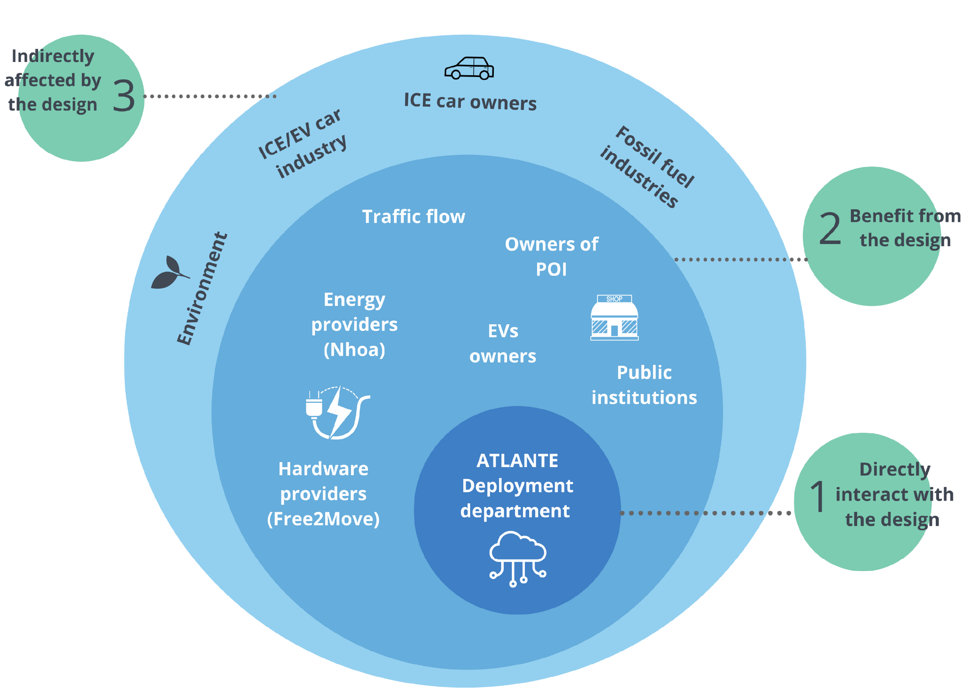
Stakeholders analysis
1
Key players
Directly interacting with the design
ATLANTE (partner company)
Informed or consulted players
Benefit from the design
Free2Move (hardware),
NHOA (energy),
EV users
2
3
Affected players
Indirectly affected by the design
Environment, ICE automotive industry
Notes:
Key to go forward: “Either positevely, like the environment, or negatively like the ICE automotive industry”
—
As i mentioned, Atlante is our partner Company that has collaborated with us throughout the whole development of the project. Thereby it has always been a key player having direct influence on the design of the tool. They required the algorithm to be: efficient, easy to use and profitable in the long run...essentially, to be the optimal one.
Then, as tier 2 players come the ones who benefit from the design choices of the algorithm. Free2Move and NHOA are partner companies to Atlante serving as hardware and energy providers, while EV users, as an instance, would benefit from the deployment of the charging stations. At the same time, their needs have been carefully implemented as considered inputs for the algorithm.
Finally, the 3rd tier of stakeholders include those who are indirectly affected by the design. Either positevely, like the environment, or negatively like the ICE automotive industry.
Da presentare tipo qualcosa del genere: Being the OASIS project primarily focused on the algorithm development, it is challenging yet essential to clarify its stakeholders and closest partners. The understanding of the available resources, as well as the presence of existing competitors, is crucial for the development of the decisional algorithm. Thus, all players involved in the project have been clustered in 3 main tiers. The team has been continuously working together with Atlante, which has provided data support, inspiring insights and continuous feedback along the development process. Setting requirements on the project outcomes, Atlante plays a key role affecting the design of the algorithm. The detailed scoring model, the meticulously implemented objective function and final WebApp aim to satisfy Atlante’s primary needs, which involve an easy-to-use but extremely efficient decision making algorithm.
Secondly, the following tier includes Atlante’s sister company: Free2Move, which acts as the primary hardware provider for charging stations installation. Here, NHOA and Public institution play a crucial role as well. Not only each player benefits from the project by expanding their market share and reaching their environmental objectives, but they also set limitations and make the project’s goals compatible with energy distribution criteria, public regulations and policies.
Lastly, the allocation algorithm must carefully pinpoint the favourable location for the end users as well. They require properly sized stations for low waiting times, which should be deployed nearby their commuting routes or favourite Points of Interest.The environment and EV industries would indirectly benefit from the realisation of the project, on the other hand ICE and fossil fuels industries might be negatively affected by such transition.

Slide 4
State of the Art
Notes:
Key to go forward: “so the project kicked off with the analysis of the state of the art solutions”

Slide 5


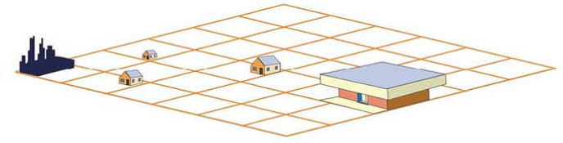

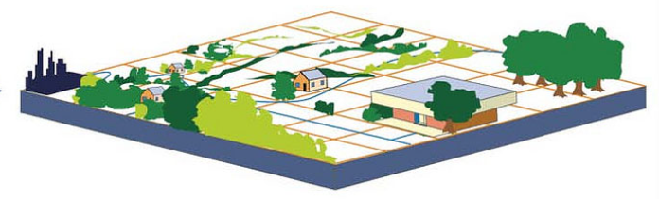
Benchmark Analysis
Primary Inputs in Charger Allocation Strategies
Users’ data
Destinations data
Routes data
Exploration of Existing Solutions for Optimal Electric Vehicle Charging Stations Allocation
GIS-based approach Graph-based approach
3
Street Data
Buildings Data
Environmental Data
2
1
Direction of Research and Existing Projects
Tesla uses a graph-based method
No predominant approach
Integrated Data
Notes:
Key to go forward: “and Routes Data describing the street network and traffic flow. “
—-
First of all, the existing strategies for optimal allocations were explored. Two main methodologies emerged: which are the GRAPH and the GIS based approaches. The team chose to focus on the GIS one, whose core idea is to use a Geographic Information System to partition the area into hexagon cells and assign to each one a suitability score for the allocation.
Secondly, no convergence over a single approach has been found. Despite, the one adopted by Tesla has been classified as a graph method, multiple studies show there are no predominant strategies currently adopted as standards of optimal allocations, further stressing the need of such technology.
Then of course, the primary inputs needed for allocation were studied. Those include users' data, as demographic information, destination data, as the details of the Points of Interest location, and Routes Data describing the street network and traffic flow.
This section is focused on answering the following research questions:
Exploration of Existing Solutions for Optimal Electric Vehicle Charger Allocation
This investigation delved into an in-depth analysis of the current solutions aimed at achieving the optimal allocation of electric vehicle chargers. Two main methodologies have been identified:
GIS-based approach: involves the use of the Geographic Information System (GIS), a system that can create, manage, analyse, and map any type of data. The core idea behind the solution is to segment the area of interest into a grid of hexagonal cells and to assign to each cell a score representing its suitability for the installation of charging stations. A decisional algorithm will then find the optimal locations, i.e., those ones with the highest score and satisfying a set of technical constraints.
Graph-based approach: involves the creation of a graph originating from a collection of nodes, representing possible locations for charging stations, interconnected through routes and links.The overarching goal might is to minimize the number of charging stations, having one per route. Alternatively, an approach might aim to maximize the traffic flow within the graph.
Direction of Research Trends Over Recent Years and Emergence of Projects and Research Groups in the Field Convergence on a single approach has not been reached. As matter of fact, a study reveals that there are no predominant strategies to optimally allocate charging stations and stresses the importance of strategically locating charging stations (CS) to ensure widespread access and usability for EV users. Information about existing projects and research groups in this field is quite limited, and only one study was identified. This study examines the approach developed by Tesla and classifies it as a graph-based method.
Primary Inputs used in Charger Allocation Strategies The potential input parameters to be considered within the optimization model are diverse and can be categorized into three primary groups:
Users’ data, entailing parameters associated with the influence of individuals, such as,demographic information and geo-location data.
Destinations’ data, encompassing details about Points of Interest (POI) and locations of existing charging stations.
Routes data, describing the street network and traffic flows.

Slide 6


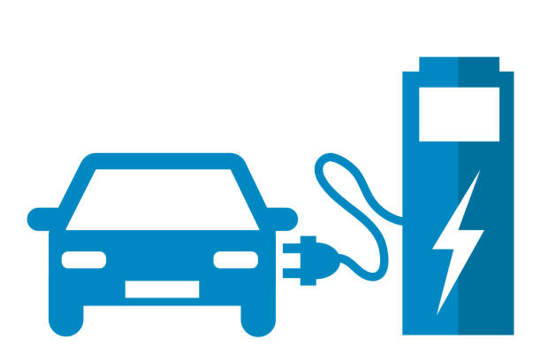
Infrastructure
Is the existing power infrastructure ready for the transition?
Grid Topology Classification
Power limits and distribution areas:
Rural
Urban
Commercial
Impact on Infrastructure
Increasing penetration rate
LV Transformers (overloading > 150%)
Charging standards
Mostly slow AC charging < 22 kW. Emerging DC fast charging up to 150 kW or more.
Upsizing and
Smart charging
Notes:
Key: “Thus, to sustain and promote the transition, upsizing and smart charging is needed.”
_____________________
Then, a crucial question emerged: is the existing power infrastructure ready for the transition? Would some areas be affected more than others?
Because of that, the different grid topology has been classified into Rural, Urban and Commercial, depending on power limits and distribution areas. Within these areas, the impact over the infrastructure was analysed through real case studies. Most importantly, in urban areas the increasing penetration rate would cause the overloading of LV transformers above their technical limit.
The last step to deliver the energy to the customer is through the charging standards. The commonly adopted solution uses slow AC charging, whereas Atlante offers an emerging technology of DC fast charging up to 150kW.
Thus, to sustain and promote the transition, upsizing and smart charging is needed.
Da presentare tipo qualcosa del genere: Of course, the growing adoption of Electric Vehicles can bring considerable challenges. Most importantly, great concern is focused on the overloading of grid infrastructure. Can the distribution lines bear the electric mobility transition? Would some areas be affected more than others? Because of these questions, the research focused on understand the different categories of Grid Topology, which can be classified depending on power limits and distribution areas. Rural, urban and commercial areas present different distribution lines and thus, further research on real case studies showed that simultaneously charging a vast number of EVs can cause transformers overloading in some cases. Over 80% penetration rate, urban areas are the ones with the most critical situation, surpassing the 150% overload standard limit of the infrastructure. Finally, the energy distribution ends to the final user, thereby charging standards were analysed. Most existing chargers nowadays use slow AC charging below 22 kW, but the usage of DC fast charging, up to 150 kW and more, is rapidly growing. Indeed, it is more favourable by the EV end users as this technology requires slower charging times, resembling previous quick fueling habits of ICE cars.
In the end, it is required that in the future the electric power infrastructure gets upsised to allow for 100% penetration rate. Additionally, smart charging techniques must be implemented to better control the loading curve during the day and to combine the usage of renewable energy sources.
—> vai a V2G

Slide 7
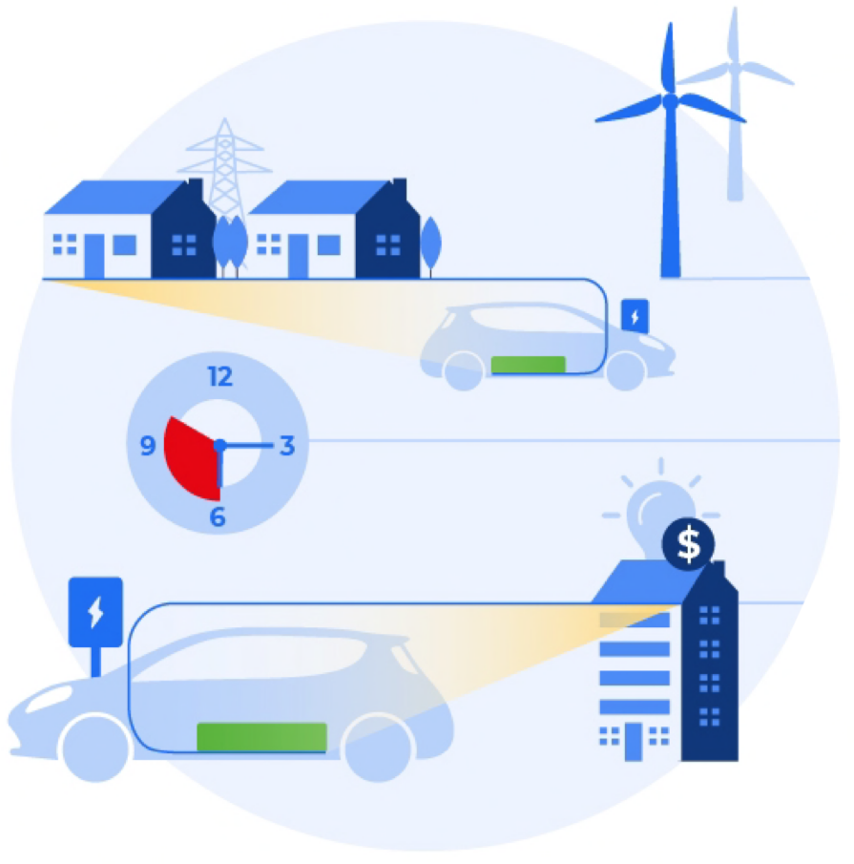
V2G Application
Vehicle-to-grid: groundbreaking innovation that allows electric vehicles to feed excess energy back to the grid rewarding the owner.
Technical, regulatory issues, and lack of large scale implementation are slowing down the diffusion
An efficient charging network fosters the adoption of EVs, and can increase the technology readiness of V2G
Notes:
Key: “consider this technology as a next step”
____________________
Speaking of smart charging, V2G is the most ground braking technological innovation emerging at present. It allows vehicles to be charged but to give back energy to the infrastructure at need! On the one hand, the user would get compensated for this process, but on the other hand it is still not a ready to use technology due to the lack of technical requirements and large scale implementation studied. The technology readiness of V2G is strictly linked to the diffusion of EVs; for this reason we decided to consider this technology as a next step, aiming to contribute to its diffusion in this way.
Vehicle-to-grid is a groundbreaking innovation that allows electric vehicles to feed excess energy back to the grid rewarding the owner → the EV becomes a mobile energy storage device Analyzing the pilot projects we concluded that:
its actual application to provide services (Firm Frequency response, Arbitrage, TRIAD, Demand Turn Up, Short Term Operating Reserve etc) must be tested on a larger scale and more data about their performances must be collected
Technical and regulatory issues are slowing down the diffusion such as: battery degradation,charger efficiency, taxation and high costs
The technology readiness of V2G is strictly linked to the diffusion of EVs and consequently to the charging infrastructure; for this reason we decided to consider this technology as a next step, shifting the focus to more feasible aspects.

Slide 8
The Solution
Notes:
Our solution is
- data driven
- based on optimization problem
- given a city, optimal area to place EV charger

Slide 9
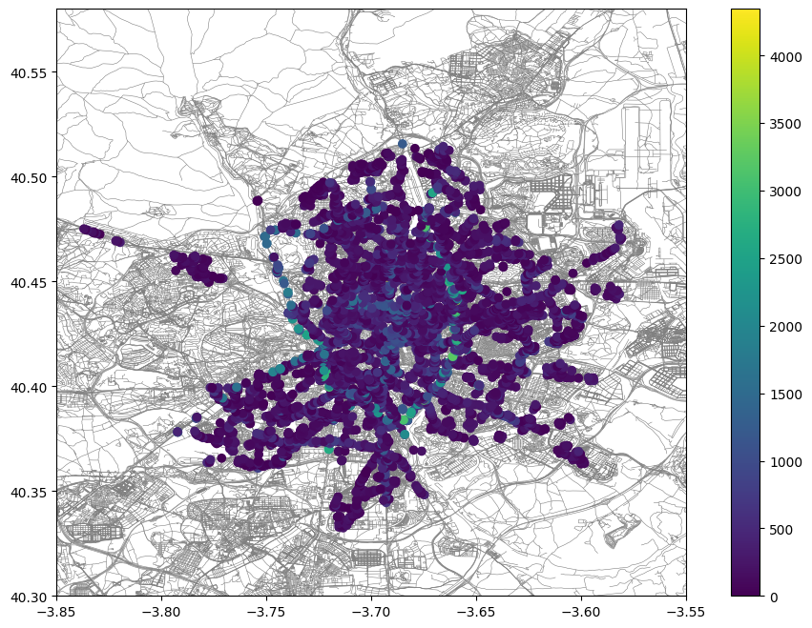
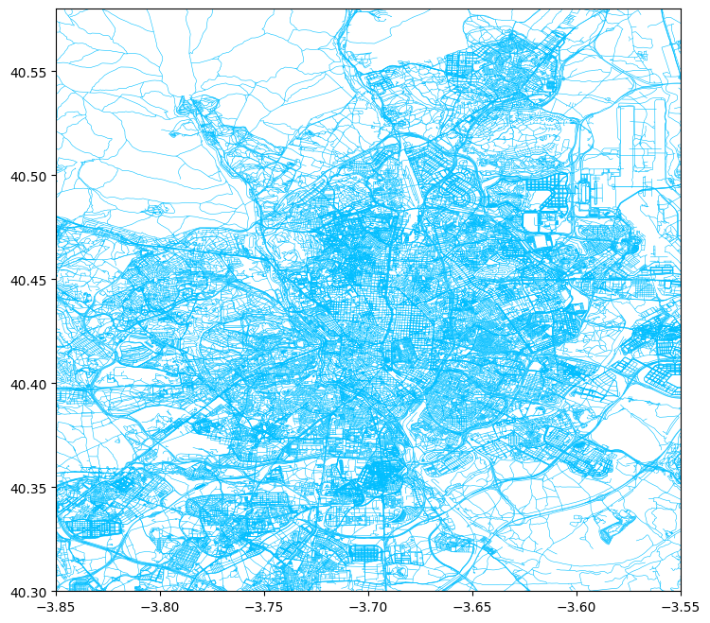
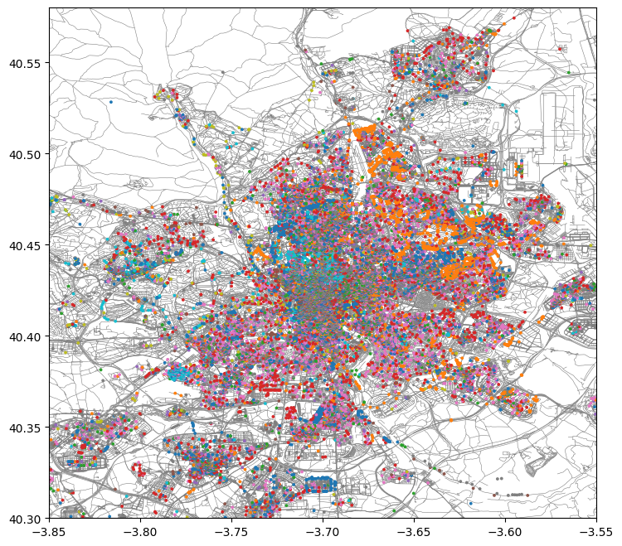
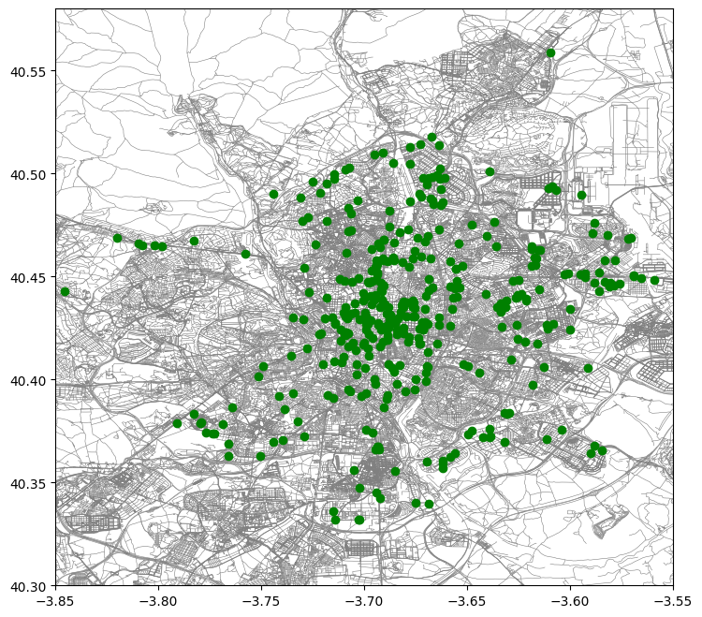
Data Pipeline
Traffic points:
UTD19
Punctual traffic
Roads configuration:
OpenStreetMap
Madrid
1
4
2
3
POI distribution:
OpenStreetMap
Weighted clusters
Charging stations:
OpenChargeMap
6 European cities
Notes:
For every city we established a pipeline: 4 datasets need to be gathered, the mean traffic points for the road network, the points of interests (that may be hospitals, schools, restaurants): both the location and the type so that they can be given different weights in the algorithm. The existing charging stations and last but not least the roads configuration.

Slide 10
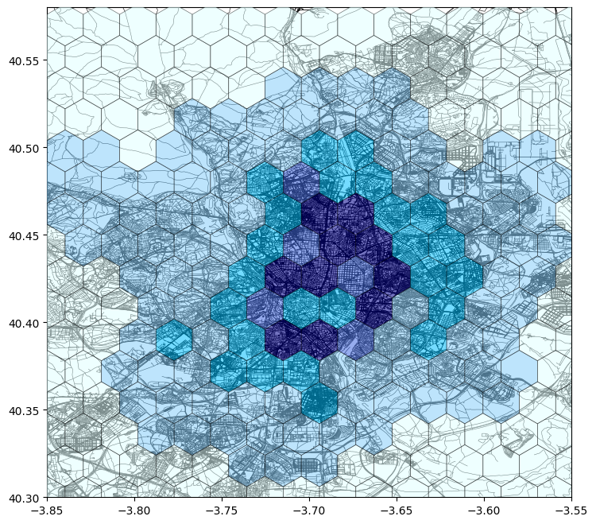
Grid Creation
Hexagonal cells
Avoid right angles and more natural boundaries for analysis.
More accurate representation of interconnected areas within the city.
Less distortion over large areas.
H8 framework
Balanced trade-off between detail and computation efficiency.
The average hexagon area, at the equator, is 0.73732 km^2.
Traffic distribution
On the right is depicted the distribution of the traffic points in each hexagon in Madrid.
Hexagonal cells
Avoid right angles
More accurate
Less distortion
H8 framework
Balanced trade-off
Fixed area for each hexagon
Notes:
We now subdivide the city in to smaller areas.
The algorithm will pinpoint some of these areas for placing the charger, and there will be the need for manual intervention to actually identify the points ( as am example the parking lots) in the cell to place the charger.
We decided to use hexagon as they avoid 90 degrees angle and allow for more accreately following the road morphology. The side of the hexagon is chosen using H8 framework, which yields a nice balance between size and accuracy.

Slide 11


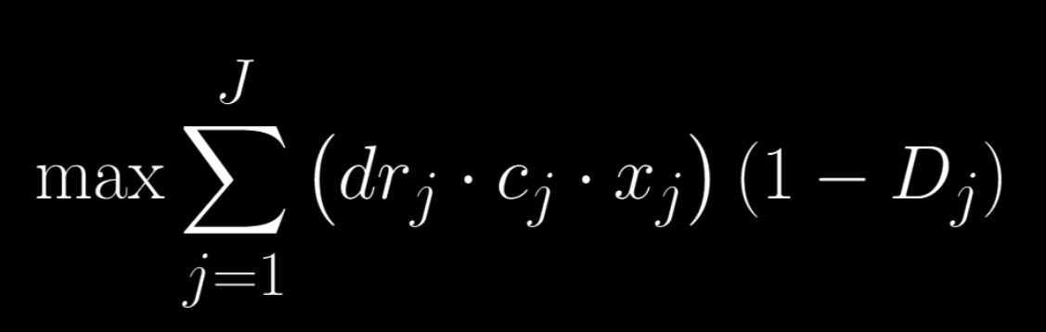


The Model
OBJECTIVE FUNCTION
Place EV charger in j?
1 = Yes
0 = No
Remaining Demand in cell j
Existing EV charger data
The “Congestion Index”
POI distance from j
POI weights and location data
Notes:
Now comes the model. An objective function is defined for every hexagon j, and then summed over all the hexagon to be maximized.
There are 4 main contributions to this function: the remaining demand in cell j, calculated using the traffic values (the higher the traffic, the higher the demand). We also use here the existing ev charger data so we can take into account the demand that is already satisfied.
Second is the decision variables x_j 1= place, 0 = n0.
To the right is the coefficient that weights the demand using the cumulative distance of the hexagon from all the points of interest.
Finally, there is a multiplicative coefficient, the congestion index: here is what it does

Slide 12













Innovative Approach
The “congestion index”
Why Google Maps API?
Motivation
Capture Flux - Road Morphology
Cost-effective
Global road coverage
Holistic data integration
API accessibility
Calculation
GMaps API Delay Time as Proxy
Integration
Multiplicative Coefficient in Model
Interpretation
Higher coefficient = Higher demand
Notes:
We devised the congestion index approach because we wanted to capture the traffic flux beyond a singular mean values, to take into account the direction of traffic and road morphology.
It’s a simple numerical index calculated using as a proxy for traffic the time delay due to traffic in travelling between hexagons. It is calculated using the google Maps API and integrated as a multiplicative coefficient, as you’ve seen.
The interpretation is straightforward: the higher the coefficient, the higher the demans: this means there’s more inbound flux compare to the outward one.
The google maps api was chosen due to ease of use, being cheap and covering the global road network.

Slide 13
Madrid Results
POI
Highway Demand interaction
City Center Demand
satisfied
Notes:
These are the results of applying the algorithm to the city of madrid. 6 EV chargers were to be placed, and you can see the recommended hexagons for placement coloured in red. A few notable results: there is a good interaction between POI and demand, all point are placed near main avenues and highway.
None is placed in the city center as the demand was already satisfied by existing chargers.

Slide 14

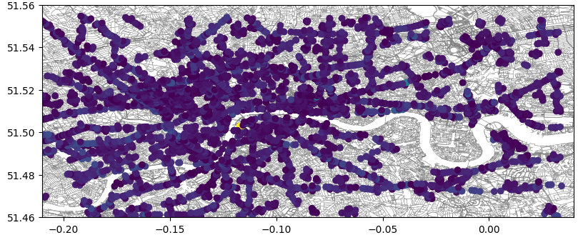
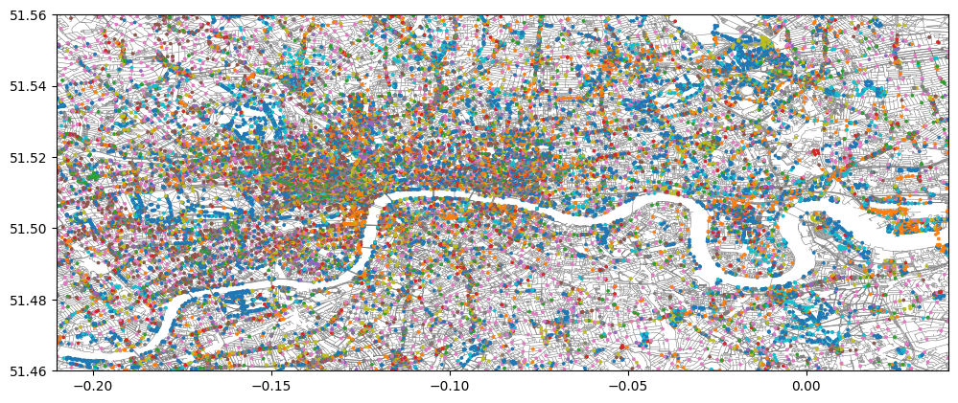
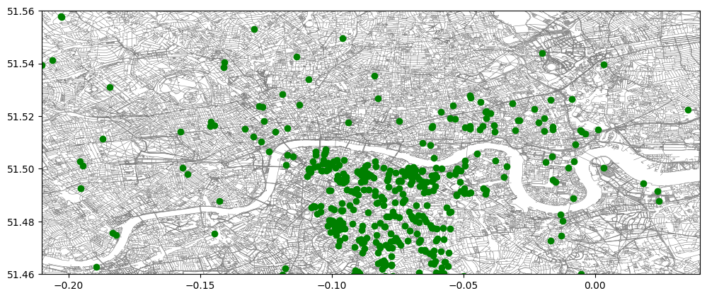


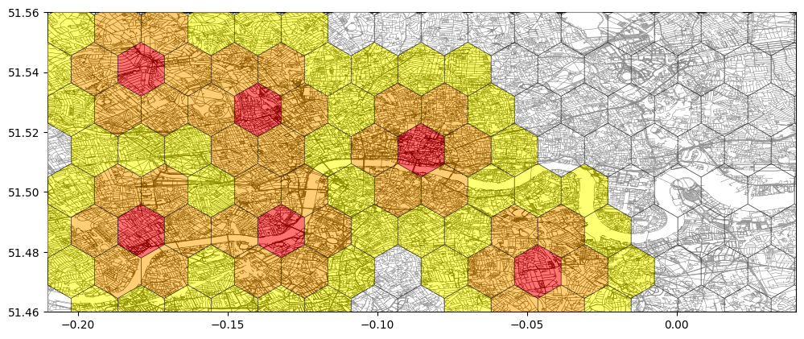
Other cities
Manchester
Traffic Points
Utrecht
Hamburg
London
Rotterdam
POIs
Existing stations
Solution
Notes:
Similar results

Slide 15

Economic Analysis
Optimization algorithm
Identifying most suitable hexagons in the area, according to objective parameters. The resulting traffic value is used as input for following phases.
Preliminary analysis Assessing overall attractiveness of an area for charging station deployment
Techno-Economic Analysis
Based on Life Cycle Cost, with the aim of identifying all economic factors related to stations placement and management
Notes:
Key to go forward: "evaluate the charging station deployment economic viability"
The proposed methodology for EV charging station placement involves two phases: the optimization phase based on factors like traffic and distance to attractions, just described (appena spiegata da slide precedenti), followed by a financial analysis phase aims at station sizing. This balanced approach ensures a comprehensive decision-making process aims to maximize expected return of investment ( qui si potrebbe spiegare meglio ma porta via tempo… se siamo corti aggiungo). The economic analysis consists of two different steps: (la divisione serve perché all’inizio valuti grossolanamente l’area, con brevi tempi di esecuzione, la seconda parte analizza con più accuratezza ma porta via più tempo) - The preliminary analysis, based on a python script, focuses on CAPEX and OPEX without cash flow actualization, calculating the breakeven point and expected return of investment, both critical parameter for assessing area profitability. - Then an Excel-based phase, aims at developing a Techno-Economic Analysis (TEA) using Life Cycle Cost Analysis (LCCA). LCCA dissects acquisition, operation, maintenance costs, and revenue streams considering the time value of money through discounting, resulting in a comprehensive financial perspective for informed decision-making. (infine si potrebbe dire che l’analisi di sensibilità serve a causa di alte variabilità delle dinamiche di mercato e/o incertezza su valori usati)

Slide 16
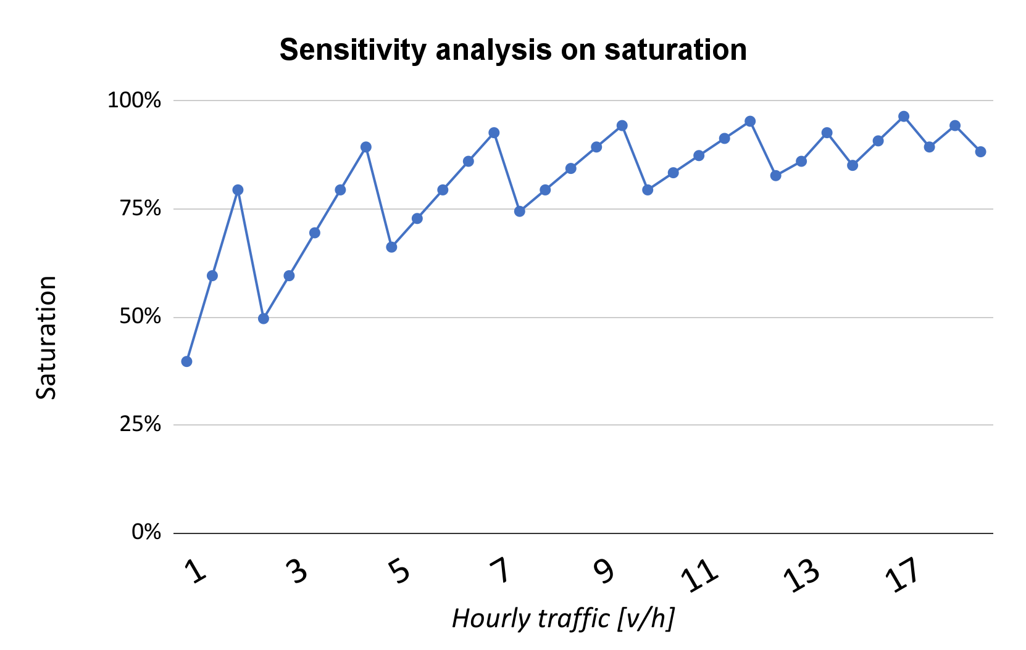
Economic Analysis
High saturation level (>80%) even for low traffic
Positive ROI even for low saturation level (>40%)
High sensitivity on tuning parameters
Acquisition Cost | 215 k€
Operating Cost | 971 k€
Maintenance Cost | 15 k€
Revenue | 1.936 k€
Income | 735 k€
Payback Period | 1,462 yrs
Discounted Payback Period | 2,267 yrs
LCC per station | -183 k€/station
ROI at 10 years | 341%
Results on hexagon #149 of Madrid
Notes:
Key to go forward: "Considering another city requires a customization of the sensitivity analysis framework since the infrastructure and consumer behaviours vary"
Evaluating the economic analysis’ results obtained for Madrid, focuses on the most heavily trafficked hexagons, it provides even insights into unstable-demand scenarios' impact on revenue streams and discounted payback periods. Concerning those results (parte sinistra del grafico) it is possible to highlight the excellent profitability of the selected spot, since the discounted payback period is very low (less than 3 years) with a very high Return of Investment in the 1o year scenario (more than 300%). However, the sensitivity analysis for Madrid reveals a sawtooth-like pattern due to discreetly increasing acquisition costs with expanding the number of stations. In addition, results strongly vary according to selected parameters, requiring to develop different sensitivity analysis able to visualize many possible scenarios. Careful sizing of charging points is therefore necessary to prevent lost sales, impacting both saturation and overall lifecycle costs. Lastly, it is important to recall the fact that the presented sensitivity analysis is tailored for Madrid's context: since the infrastructure and consumer behaviors vary across cities, customization of the sensitivity analysis framework is crucial to extend results even to other cities.
The economic analysis focuses on the most heavily trafficked hexagons among the six strategically significant ones, providing insights into high-demand scenarios' impact on revenue streams and discounted payback periods. This approach assesses the financial feasibility of EV charging station deployment in areas with maximum user adoption and revenue potential. It's essential to recognize that the presented sensitivity analysis is tailored for Madrid's context. Urban landscapes, infrastructure, and consumer behaviors vary across cities, requiring customization of the sensitivity analysis framework for accurate insights and informed decision-making in each unique environment. The sensitivity analysis in Madrid's EV environment reveals a sawtooth-like pattern due to discreetly increasing acquisition costs with expanding the number of stations. Careful sizing of discharge points is necessary to prevent lost sales, impacting both station and overall lifecycle costs. Different traffic scenarios show varying effects on station expansion, requiring a decision based on profitability and inter-PoD comparisons to optimize investment realization. (qui pure potrei spiegare meglio ma allungando…)

Slide 17
The End?

Slide 18





Future developments
1
3
Refine the
Inner Hexagon Analysis
Fully automated
Data Extraction Pipeline
Refine the
Optimization Process
Include
Economic Analysis
In the model
2
4
Range = 340 km
Notes:
Key to go forward: "by taking data like energy prices from reliable sources."
During the design process, a lot of possible additional feature and refinement came in our mind. Some have been successfully implemented, others have been left as suggestions. For examples,
- The optimization process may take into account indexes, like the population density or a more precise range for the electric vehicle, tailored to the considered city, with its different altimetry level, weather and road surface.
- Then, considering the single hexagon, the optimal choice of the site may further restricted, considering factors like the local shape of the buildings, actual space needed for the single charger, and limitations given by the necessity of architectural integration
-In addition, to make the algorithm closer to being optimal, the financial aspect may be incorporated into the optimization function, reaching a better compromise between strategic placement and profitability;
- Finally, the final aim would be to make the data-extraction pipeline fully automated, by taking data like energy prices from reliable sources.

Slide 19
Conclusions
1
Scalability
Layered structure of GIS model allows to add more data
Economic Feasibility
Features able to assess a possible economic return
2
3
Sustainability
Current infrastructure and energy demand are taken into account
User Friendliness
Dedicated Web App tool for end users
4
Notes:
Key to go forward: "we have developed a WebApp so that the final user can easily interact with it"

Slide 20






THANK YOU FOR YOUR ATTENTION

Slide 21
Backup Slides

Slide 22
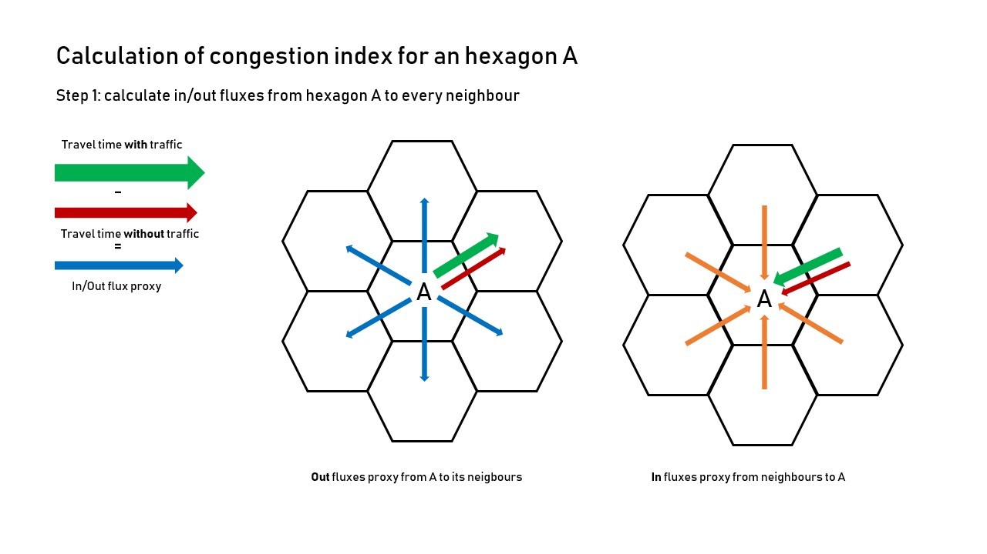
Innovative Approach

Slide 23
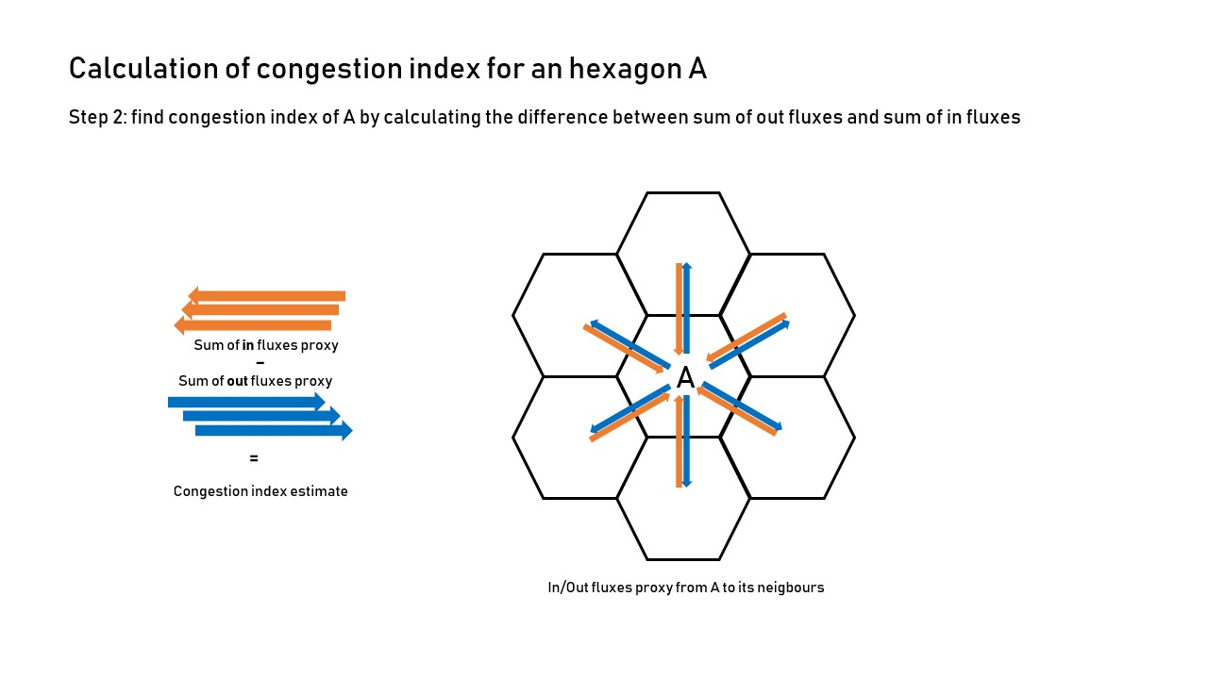
Innovative Approach

Slide 24
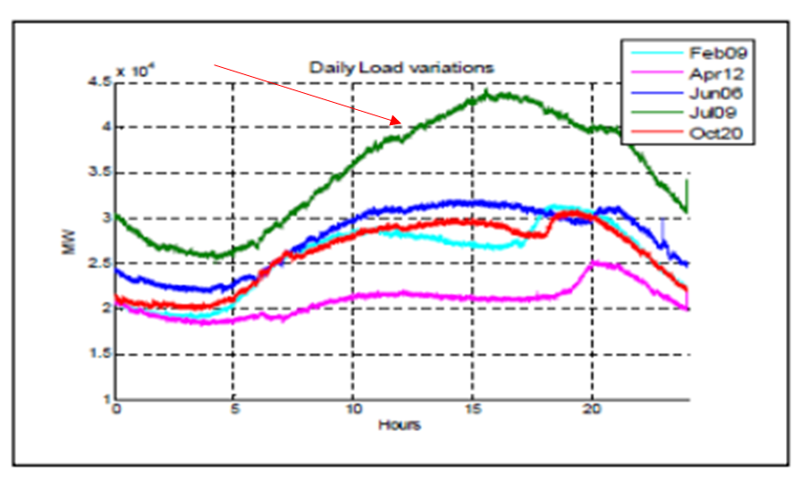
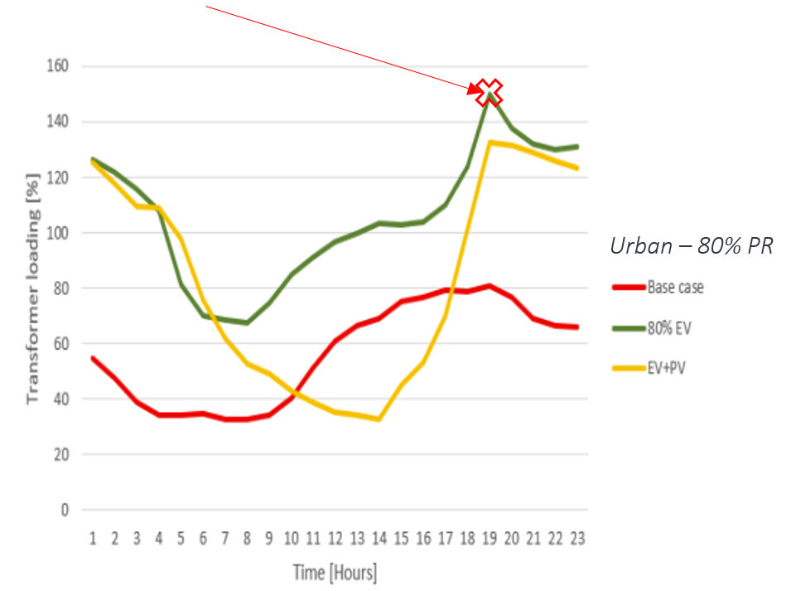
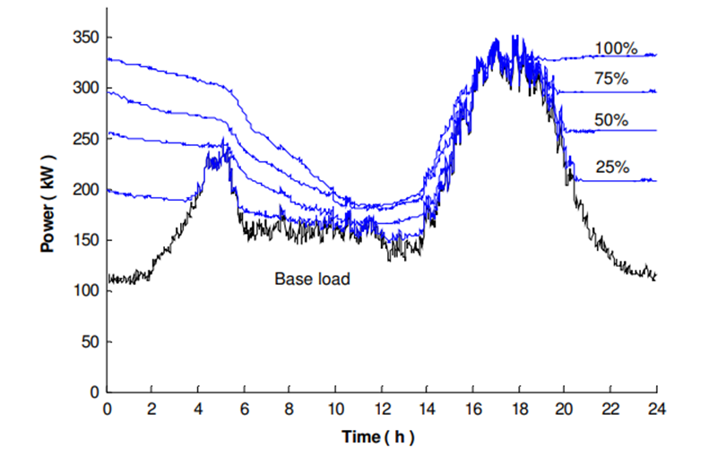
Case Studies
Californian load curves - Seasonality
Italian Urban topology - Overloading of LV Transformers
Finnish Smart Charging - shift of the request

Slide 25
Economic analysis
Input parameters
Input Data |  | Electric charging station
 |  |  | avg
Lifetime, n (years) | [yr] |  | 10
Acquisition Cost | [€/station] |  | 45000
Energy management Cost | [€/pod] |  | 25,88
Power fee | [€/kW] |  | 58,25
Distance fee | [€/pod] |  | 535,98
Vehicle Capacity, C_EV | [kWh] |  | 50
Energy Cost, C_elec | [€/kWh] |  | 0,21
Annual Maintenance Cost, MCi | [€/(station*yr)] |  | 500
Annual power fee | [€/(kW*yr)] |  | 46,25
Annual energy management Cost | [€/yr] |  | 1113,24
Profit Margin | [%] |  | 100,00%
Selling Price P_EV | [€/kWh] |  | 0,6
Charging Efficiency η_c | [%] |  | 90,00%
Interest rate | [%] |  | 5,50%
No. of Vehicles Servable per Day (nEV) | [] |  | 40,61
Utilization rate | [%] |  | 31%
Working hours | [h] |  | 7,52
Charging power | [kW] |  | 150
Charging percentage | [%] |  | 50%
 |  |  | 4708135
Traffic in a minute | [vehicles/m] |  | 8,96
Daily traffic | [vehicles/day] |  | 12899

Slide 26
Economic analysis

Slide 27
Economic analysis
LCC/station

Slide 29

Conclusions

Slide 30
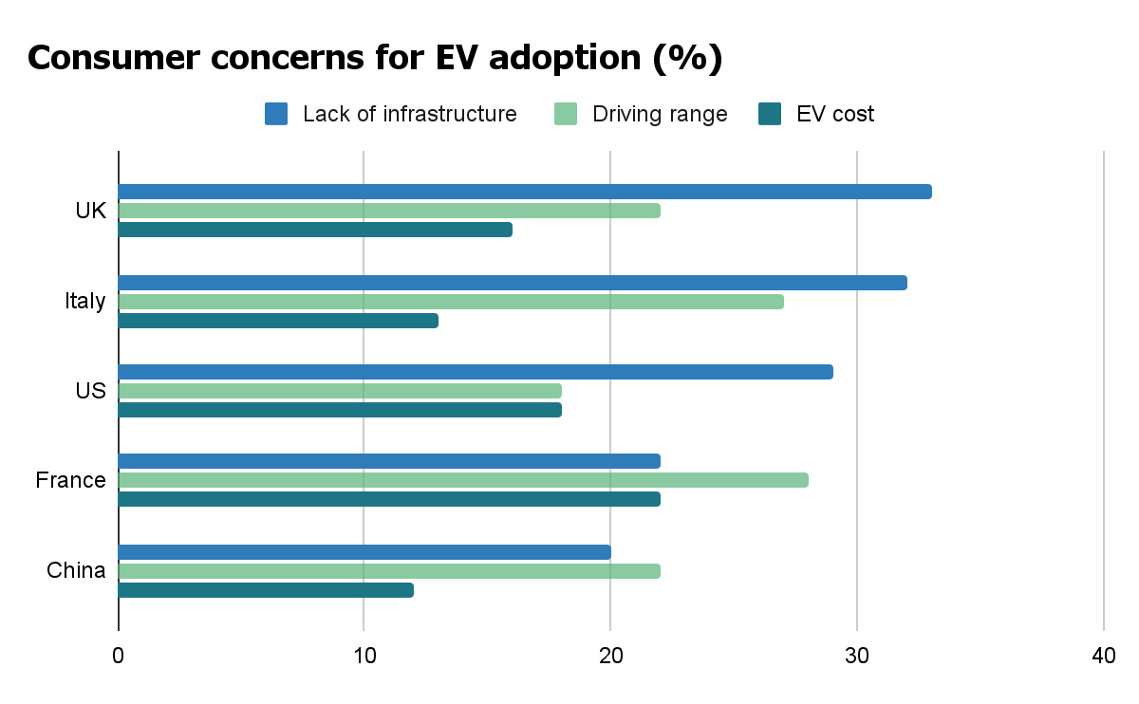
Introduction
In most countries the lack of electric vehicle charging infrastructure figures as a top concern regarding the adoption of an EVs
OASIS mission: Optimal Allocation and Sizing of Electric Infrastructures basing on Predictive Simulations
Notes:
Key to go forward: “strategic positioning of superfast chargers, aiming to contribute to the mobility transition”
—----
As a study from Deloitte shows, the main concern that prevents the Electric Vehicle adoption is IN FACT the lack of available charging infrastructure.
The mission of the OASIS team is exactly to solve this obstacle!
To do so we provide our company partners, ATLANTE, with a tool based on predictive simulations that supports the strategic positioning of superfast chargers, aiming to contribute to the mobility transition.
A study from Deloitte shows that the charging infrastructure is the top concern among customers in most countries; highlighting the relevance of this project
In this context the mission of the OASIS team is to provide Atlante (our company partners) with a tool that supports the strategic positioning of fast charging electric infrastructures; OASIS= Optimal Allocation and Sizing of Infrastructures basing on predictive simulations

